Slide 1
Transit Terminal Display
12/4/2025

Slide 2



Base Station Server
LoRa RF
915MHz
Arduino MKR WAN 1310
or
Raspberry Pi running
Custom Python server application accepts TCP/IP connections on port 3141
TCP/IP in
Serial (UART)
Feather M0 LoRa95
$BSTXT,0A,color|green|\ntext|0|Hello World\n*
$BSTXT,0A,color|green|\ntext|0|Hello World\n*33

Slide 3
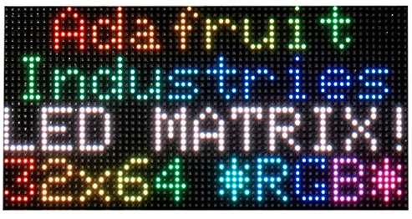
Bus Stop Display
LoRa RF
915MHz
Arduino MKR WAN 1310
or
Matrix Portal M4
Serial (UART)
Feather M0 LoRa95
$BSTXT,0A,color|green|\ntext|0|Hello World\n*
color|green|
text|0|Hello World

Slide 4
Software Components
Basestation
  Raspberry Pi – basestation.py
  Arduino Sketches (LoRa Module)
  Feather M0 - Basestation-Feather-M0.ino
  Arduino MKR WAN – 1310 - Basestation-MKR-WAN-1310.ino
Bus Stop
  Arduino Sketches (Lora Module)
  Feather M0 - BusStop-Feather-M0.ino
  Arduino MKR WAN – 1310 - BusStop-MKR-WAN-1310.ino
  Arduino sketches (display)
  Matrix-Portal-Display-Driver.ino

Slide 5
Next Week
Review BOM
Setup of Arduino IDE and programming modules
Review of Solar Power system types of connectors
Antennas and RF cabling
Lightning Protection
Use of site survey equipment (hiker)
Follow on procurements

Slide 6
Discussion Area and some next steps
Baud rate vs range
Repeat mode (for some bus stops?)
Timing of messaging to avoid collisions in repeat mode
Acknowledgements (ack)
Encryption or RF? tinyAES?
Change LoRa sync word from 0x34 ?
Define what stops repeat to….
Chassis for base station and Bus Stop displays

Slide 7
Site Survey
Base Station
  Mounting antenna
  Cable runs
  Grounding systems
  Power and internet
  Mounting base station hardware
Bus stop
Panel mounting
Battery box mounting
Bus stop display mounting
Cable runs
Available power?
Security/ vandalism

Slide 8
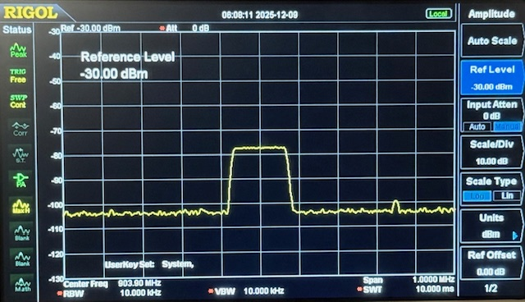
LoRa Spectrum (125KHz BW)

Slide 9
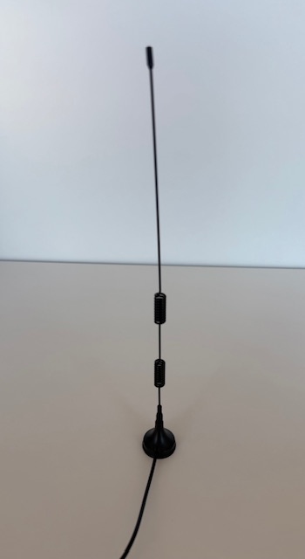
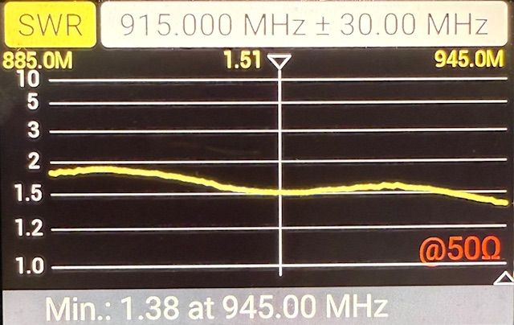
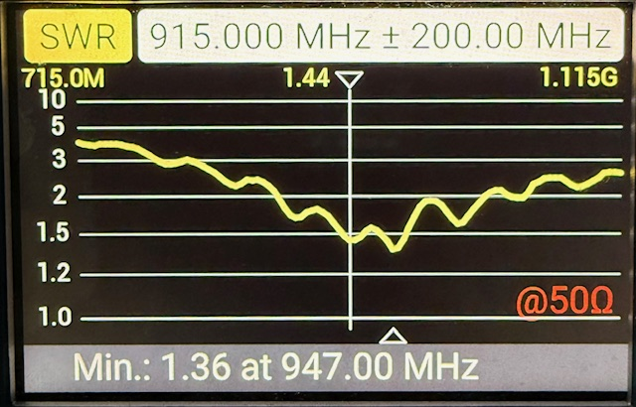
Amazon – inexpensive LoRa Antenna VSWR

Slide 10
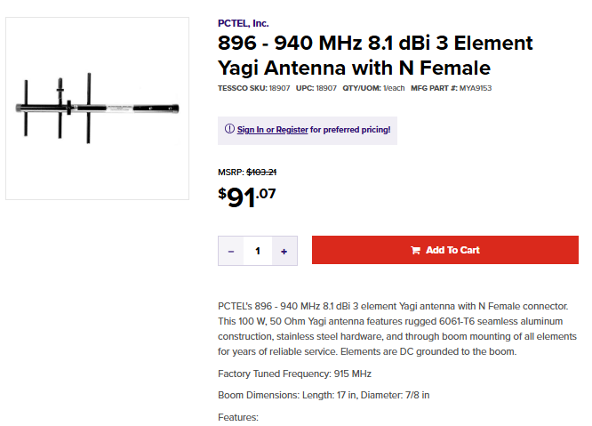
Transit Station Antenna

Slide 11
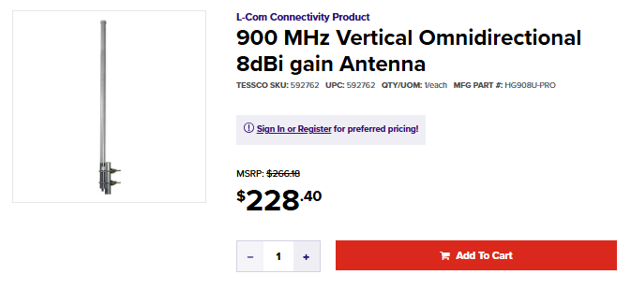
Base Station Antenna

Slide 12
